Slide 1
Market Basket Analysis for Enhanced Game Bundling and Cross-Promotion Strategies
Executive Team Presentation
August 13th, 2024
Presented by: Jake Charney

Slide 2
Introduction
Background:
Industry Challenge: In the competitive gaming industry, attracting customers and maximizing transaction value is crucial.
Client Need: A leading gaming platform seeks to leverage data analytics to gain a competitive edge through informed marketing strategies.
Project Objective:
Analyze Game Purchase Patterns: Identify strong associations between games frequently bought together.
Drive Strategic Decisions: Use insights to optimize bundling, cross-promotion, and personalized marketing strategies.
Expected Outcomes:
Increase Sales: Through effective bundling and cross-promotions.
Enhance Customer Engagement: By tailoring offers to individual preferences.
Boost Conversion Rates: By promoting products based on customer purchase history.

Slide 3
Business Context and Relevance
Business Context: The platform has access to extensive data on customer purchases but has not yet utilized this information to its full potential. The goal is to convert this raw data into strategic knowledge that can drive higher sales volumes and increase customer engagement.
Relevance to Client:
Enhanced marketing strategies through data-driven insights.
Improved customer retention and increased sales through effective bundling and personalized marketing campaigns.

Slide 4
Project Objectives
Identify strong associations between games.
Analyze the impact on sales and marketing strategies.
Provide actionable insights for cross-promotion and bundling.

Slide 5
Methodology Overview
Data Preprocessing: Detail the steps taken to clean and prepare data, including handling of missing values and data transformation.
Feature Engineering: Discuss the creation of new variables to better understand purchasing patterns, such as purchase frequency and game attributes.

Slide 6
Market Basket Analysis Technique
Apriori Algorithm: selected for its efficiency in dealing with large datasets and its ability to generate useful rules for market basket analysis.
Lift: used to understand the strength of an association relative to the randomness.
Confidence: measured to determine the likelihood that purchasing one game leads to the purchase of another.
Support: used to measure how often an item set appears in the dataset.

Slide 7
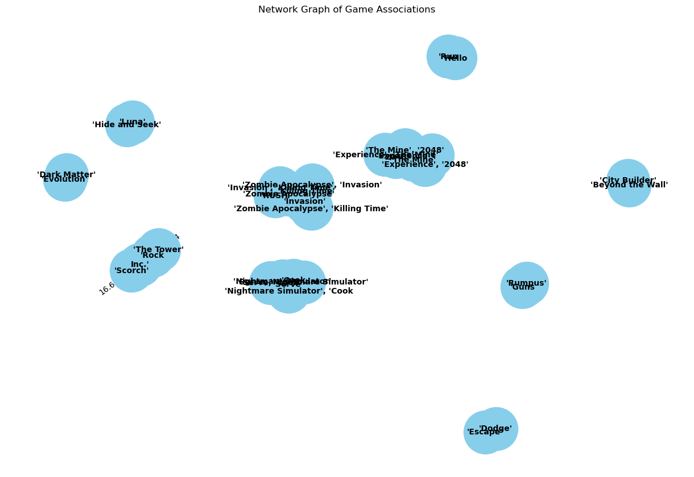
Network Graph of Game Associations (Figure 1)
The network graph visually represents the associations between games based on the rules generated from the Market Basket Analysis. Each node in the graph represents a game, while the edges denote the strength of the association between games, with thicker lines indicating stronger associations (higher lift).

Slide 8
Purpose: This graph is crucial for quickly identifying clusters of games that are frequently purchased together. It provides an intuitive visual understanding of how games are connected within the purchasing behavior of customers.
Business Relevance: By examining the clusters and the strength of connections, marketing teams can identify potential game pairs or groups for targeted promotions and bundling.
Location in Report: This should be the first figure in the results section to give an immediate visual impression of the game associations.

Slide 9
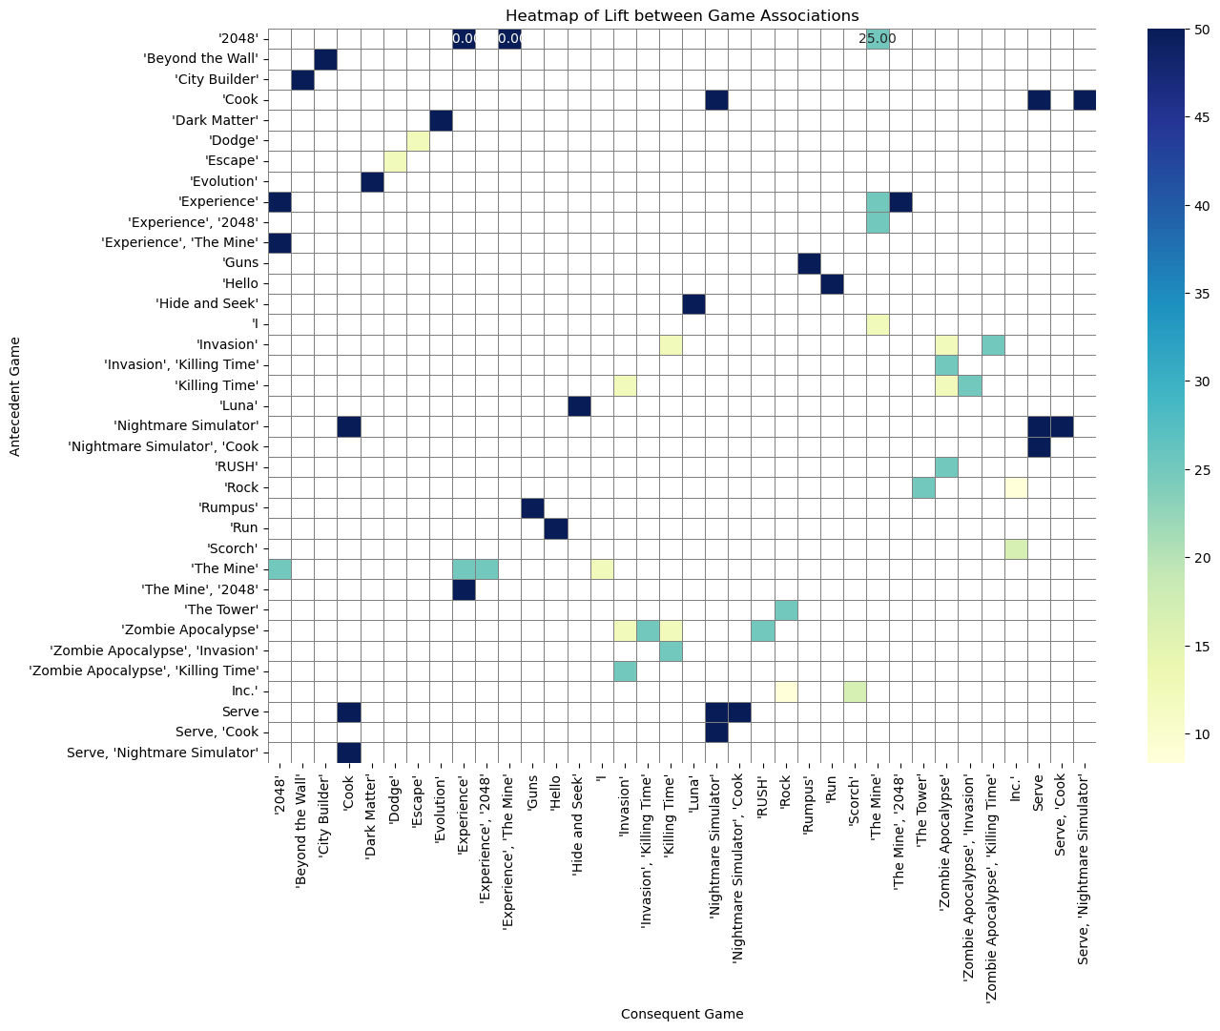
Heatmap of Lift between Game Associations (Figure 2: Lift Heatmap)
The heatmap displays the lift values for each game pair, providing a color-coded matrix that helps identify which game combinations have the strongest associations. Lift values greater than one indicate that games are more likely to be bought together than would be expected by chance.

Slide 10
Purpose: This visualization helps pinpoint specific game pairs with the highest lift, indicating the strongest positive relationships.
Business Relevance: Such insights are particularly valuable for formulating bundling strategies, as they highlight the combinations that are most appealing to customers.
Location in Report: Place this figure right after the network graph to deepen the understanding of the strength of associations quantitatively.

Slide 11
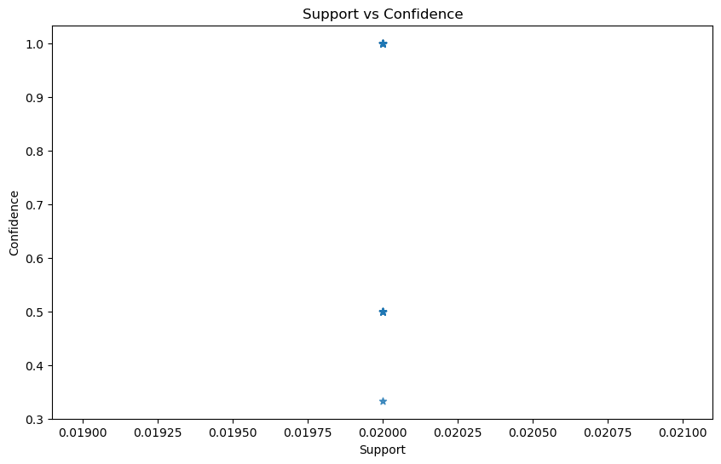
Scatter Plot of Support vs. Confidence (Figure 3)
A scatter plot can be used to plot the support against the confidence of the rules. Each point represents a rule, with its placement determined by the rule's support (x-axis) and confidence (y-axis).

Slide 12
Purpose: This plot is used to evaluate the balance between how often a rule is applicable (support) and how frequently it proves true (confidence). It helps in filtering the rules for those that strike an optimal balance, potentially highlighting different tiers of associations.
Business Relevance: Understanding these metrics in tandem helps in prioritizing which rules to act on based on their reliability and impact.
Location in Report: This figure should follow the heatmap to provide a statistical backdrop to the earlier visual insights, aiding in a deeper analytical understanding of the association rules.

Slide 13
Detailed Analytical Findings
Strategic Marketing and Targeting
The identified strong associations between games suggest specific targeting strategies could be highly effective
Bundling and Pricing Strategies
The analysis revealed several game pairs and groups with high lift and confidence levels, suggesting they are frequently purchased together more than would be expected by chance. This insight provides a solid foundation for bundling these games together at a discounted rate, which could increase the overall transaction value.

Slide 14
Findings Continued
Inventory and Supply Chain Management
Insights into the most frequently purchased games and the associations between different games can help in managing inventory more effectively. By anticipating higher demand for certain games together, the client can better manage stock levels to meet customer demand without overstocking, thereby optimizing supply chain operations.
Customer Retention and Loyalty
By offering tailored recommendations and bundles based on proven purchasing patterns, the client can increase customer retention and loyalty. Personalized marketing is seen as more customer-centric and is appreciated by consumers, leading to repeated sales and enhanced customer engagement.
Engaging customers with relevant recommendations can transform a single-purchase visit into a longer browsing session, increasing the chances of additional purchases.

Slide 15
Recommendations
Cross-Promotional Campaigns: Implementing targeted cross-promotional campaigns for games that are frequently bought together can encourage customers to make additional purchases that they might not have considered otherwise.
Dynamic Bundle Offers: Creating dynamic bundle offers that can be adjusted in real-time based on purchasing trends and the popularity of certain game combinations can help in capturing the market more effectively.
Customer Insights: The data derived from this analysis can be integrated into customer relationship management (CRM) systems to provide sales teams and marketing professionals with valuable insights into customer preferences and buying behavior

Slide 16
Further Research
Integration of Customer Demographics:
Future analyses could incorporate demographic data such as age, location, and gaming preferences to segment the market more effectively.
Seasonal and Temporal Analysis:
Analyzing purchasing patterns over different times (e.g., weekends vs. weekdays) and during specific seasons or sales events (like Black Friday or holiday seasons) could uncover temporal trends that affect buying behavior.
Machine Learning Predictive Models:
Developing predictive models using machine learning techniques could forecast future buying trends based on historical data. This approach would provide an anticipatory tool for inventory management and marketing, ensuring that the client can adapt strategies proactively.

Slide 17
Conclusion
This project successfully applied Market Basket Analysis to identify significant associations between games sold on a major online platform, providing a robust foundation for enhanced marketing strategies:
Strategic Insights: The analysis identified key game pairs with strong purchasing associations, suggesting potential bundles that could appeal to our client's customer base.
Actionable Recommendations: Based on the findings, specific recommendations were made for cross-promotion and bundling strategies, which are expected to increase both sales and customer satisfaction

Slide 18

Thanks!
Contact us:
Your Company
123 Your Street
Your City, ST 12345
no_reply@example.com
www.example.com

